Slide 1
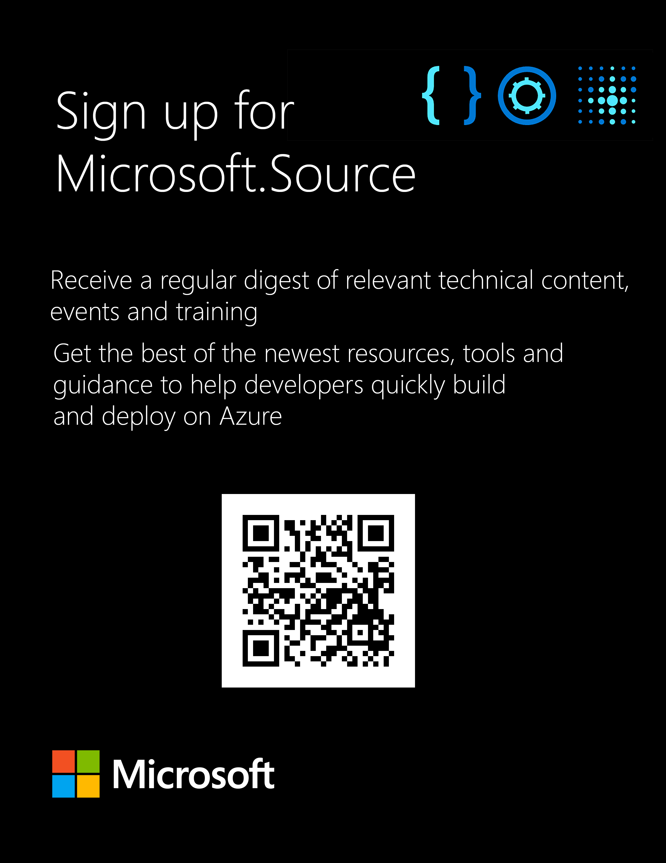
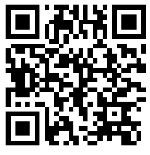
Get the latest articles, documentation, and events from Microsoft.Source—the curated monthly developer community newsletter.
Stay at the forefront of rapidly evolving technologies with resources that are relevant to your field, location, and areas of interest—including articles, GitHub repositories, and how-to guides.
Get notified about events—from local hacks, workshops, and training sessions to virtual meetups and global conferences.
Learn what you want, when you want, how you want. Resources include in-person hands-on workshops, free, interactive online training and sandbox environments.
https://aka.ms/AAn49yh

Slide 2
Azure Deployment Environments
John Folberth | Senior Cloud Solutions Architect | Microsoft
https://aka.ms/AAn49yh​

Slide 3

Experience with Azure Deployment Environments’?
https://aka.ms/AAn49yh​

Slide 4

What Are They?
On Demand Azure Infrastructure
Custom Templates connected to Catalog
Provide a self-service experience without giving control over subscriptions.
Track costs and ensure compliance with enterprise governance policies.
Azure Cost- Free!

Slide 5
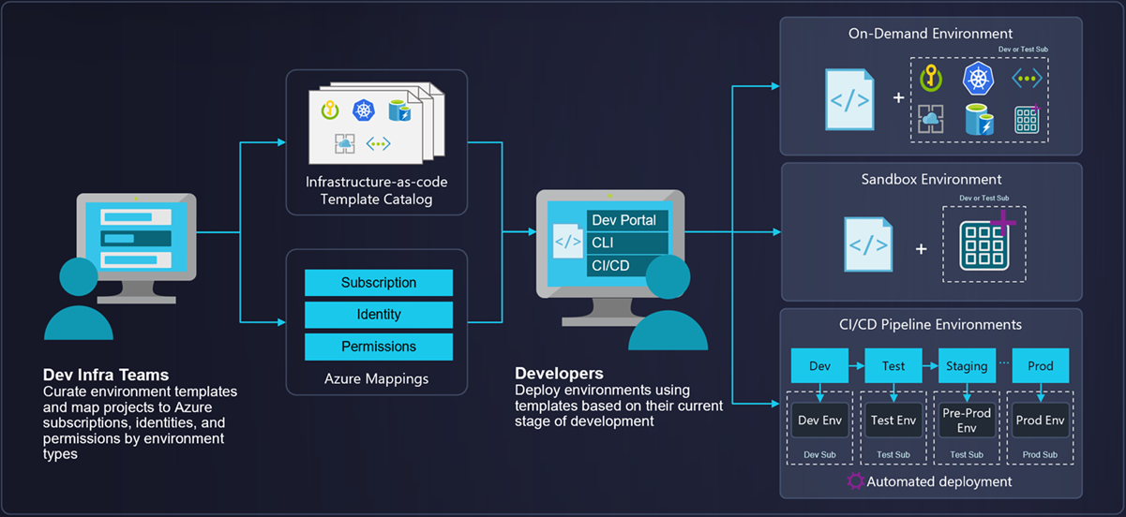
https://aka.ms/AAn49yh​

Slide 6
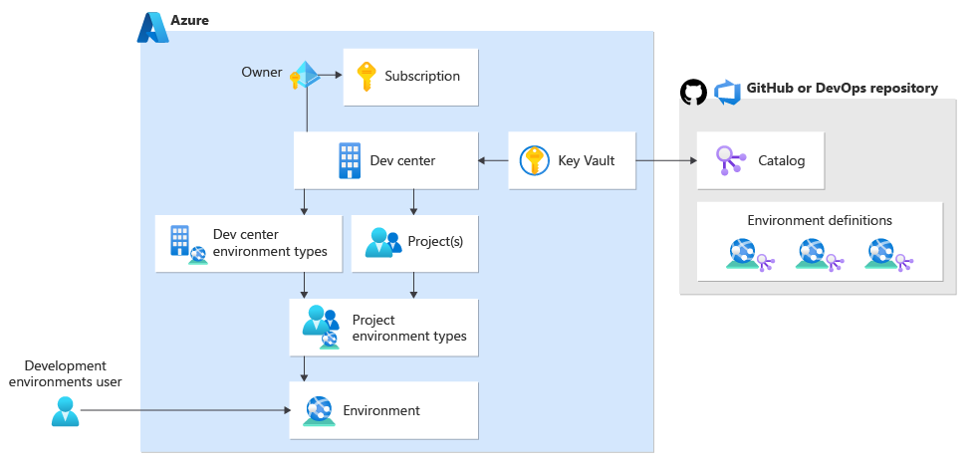
https://aka.ms/AAn49yh​

Slide 7
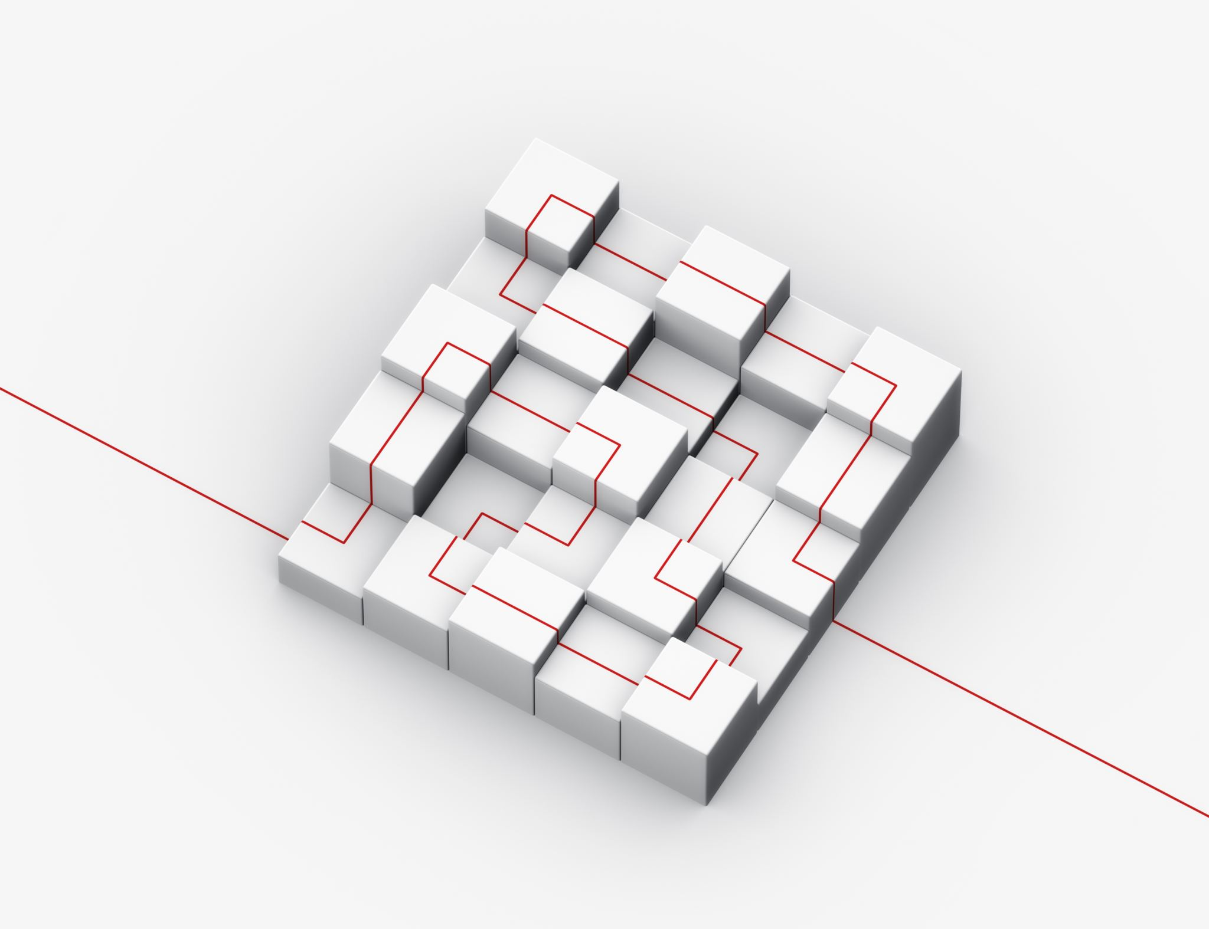
What we will cover
Illustrate use case of creating and provisioning a Sandbox Resource Group
Scenario where create infrastructure for UI with data dependencies
Walkthrough one scenario of integrating Azure Load Testing with Azure Deployment Environments in the CI/CD process.
https://aka.ms/AAn49yh​

Slide 8
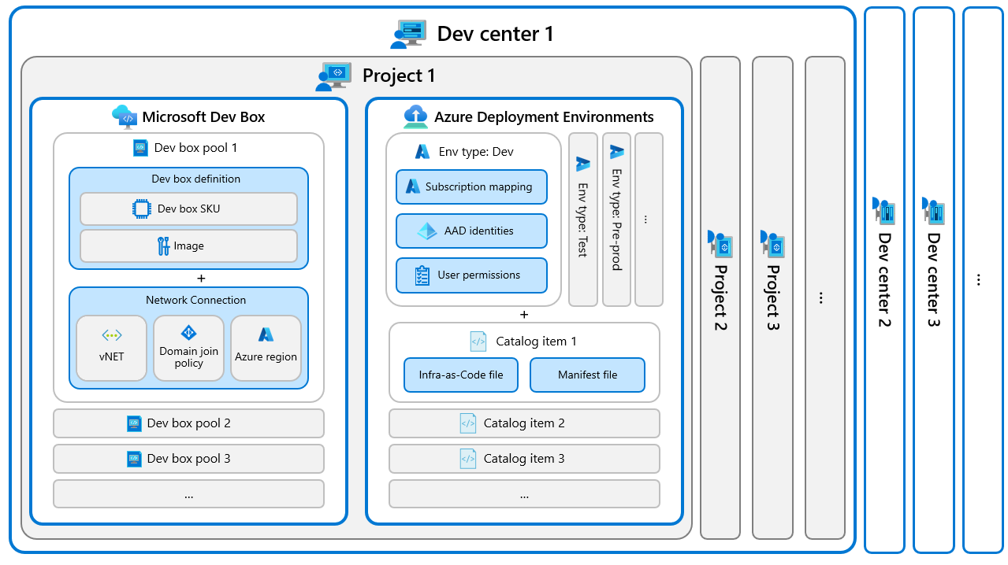
Limitations/Good to Know
Catalog items only support ARM (Terraform in Private Preview)
Cannot use Guest Accounts
Deployment Environment and Dev Boxes go hand in hand
https://aka.ms/AAn49yh​

Slide 9
Sandbox Scenario
Background: Operations wants to limit developer’s ability to make edits in Azure. This would include non prod environments.
Development Ask: I need a space and access to create Azure Resources and Assign needed permissions for a new application
Solution: Deployment Environment with a catalog for Resource Group Creation that will assign the user Contributor and User Access Admin
https://aka.ms/AAn49yh​

Slide 10
Local Dev Scenario
Background: Data and Web are in separate resource groups and owned by separate teams. There is a single log analytics workspace for log ingestion.
Development Ask: Multiple developers want to make changes to the front end simultaneously and leverage the data and logging sources already in place.
Solution: A template that contains the IaC template and a Catalog that accepts the names of the existing resources.
https://aka.ms/AAn49yh​

Slide 11
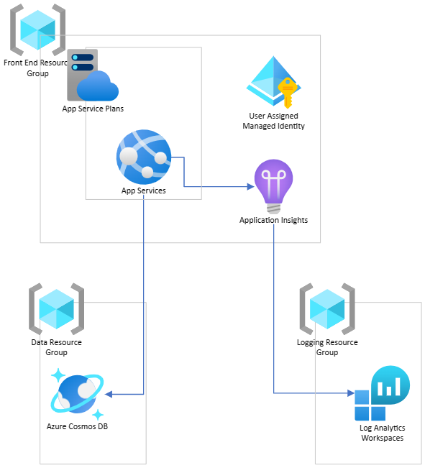
Architecture
https://aka.ms/AAn49yh​

Slide 12


Bicep Structure
Assumption: Developer teams need to leverage a set of enterprise golden templates
App Service Plan template
App Service Template
Service X Template
https://aka.ms/AAn49yh​

Slide 13
CI/CD Scenario
Background: Organization would like to shift left their developer practices. Currently their testing is performed in a static test environment after code has already been deployed.
Development Ask: As a developer I’d like to create an ephemeral environment on Pull Request to execute things like load testing.
Solution: User Azure DevOps on pull request create an Azure Deployment Environment, deploy code to the new environment, call Azure Load Testing, destroy the environment after the tests.
https://aka.ms/AAn49yh​

Slide 14



Pull Request Workflow
Create ADE
Run Azure Load Test
Destroy ADE

Slide 15

Lessons Learned
Template Scoping
Optimized for Resource Group Deployments
Should have a strong grasp on modularization
Will dictate ADE values being passed in
Refresh the Catalog!!
Depending on organization could be another layer or a way to increase developer productivity

Slide 16

Q & A

Slide 17
Get the latest articles, documentation, and events from Microsoft.Source—the curated monthly developer community newsletter.
Stay at the forefront of rapidly evolving technologies with resources that are relevant to your field, location, and areas of interest—including articles, GitHub repositories, and how-to guides.
Get notified about events—from local hacks, workshops, and training sessions to virtual meetups and global conferences.
Learn what you want, when you want, how you want. Resources include in-person hands-on workshops, free, interactive online training and sandbox environments.
https://aka.ms/AAn49yh

